Slide 1
SDLC and Its methodologies
Achieving Agile and Efficient Software Development

Slide 2
Introduction to SDLC (Software Development Life Cycle)
SDLC is a process used to design, develop, and deliver high-quality software applications.
Overview of the different stages involved in SDLC.
Waterfall Model
Agile Model
Iterative Model
V-shaped Model
Big Bang Model
Spiral Model

Slide 3
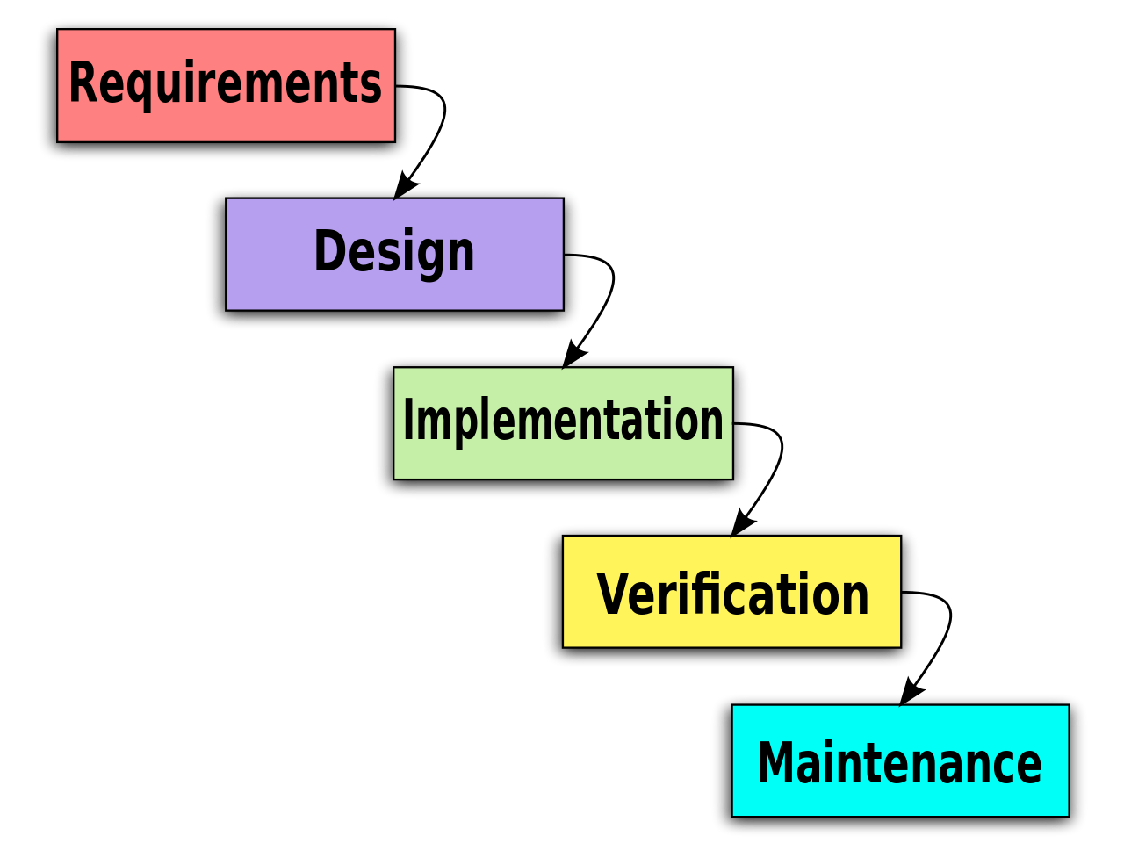
Waterfall Model
Sequential approach with distinct phases: Requirements, Design, Implementation, Testing, Deployment, and Maintenance.
Pros: Well-defined and structured, suitable for stable and predictable projects.
Cons: Lack of flexibility, limited scope for feedback and changes.

Slide 4
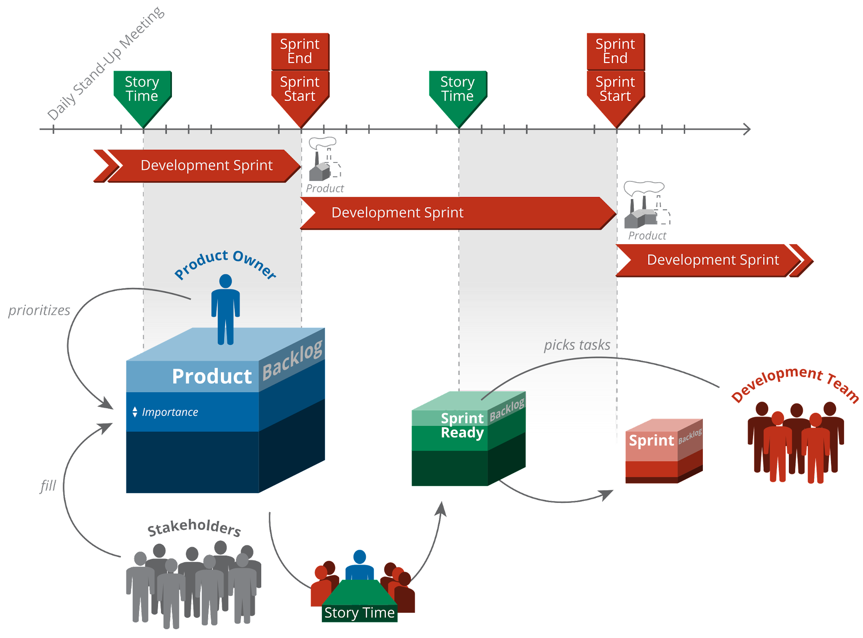
Agile Methodology

Slide 5
Agile Methodology
Iterative and incremental approach with continuous collaboration and customer involvement.
Popular frameworks: Scrum, Kanban, Extreme Programming (XP).
Pros: Adaptability to changing requirements, faster delivery, customer-centricity.
Cons: Requires strong team collaboration and active customer participation.

Slide 6
DevOps and Agile Alignment
DevOps complements Agile by integrating development and operations teams for seamless collaboration and continuous delivery.
Agile principles support DevOps practices such as automation, frequent releases, and continuous feedback.

Slide 7
Continuous Integration/Continuous Delivery (CI/CD)
CI: Frequent code integration, automated builds, and unit testing.
CD: Automated deployment to different environments, continuous monitoring, and feedback loops.
Benefits: Faster time-to-market, higher quality, reduced risk, and efficient software releases.

Slide 8
Lean Development
Principles of Lean: Eliminate waste, amplify learning, empower the team, deliver as fast as possible, and build quality in.
Focus on delivering value and reducing non-value-added activities.
Key practices: Value stream mapping, Kanban boards, and continuous improvement.

Slide 9
DevOps and Lean Development Alignment
DevOps leverages Lean principles to optimize the software delivery process, eliminate waste, and improve efficiency.
Lean practices support DevOps through value stream mapping, visual management, and continuous improvement.

Slide 10
Choosing the Right Approach
Consider factors like project scope, complexity, team size, and customer involvement when selecting an SDLC model or methodology.
Tailor the approach to fit your organization's culture, goals, and specific project requirements.

Slide 11
Conclusion
SDLC models and methodologies play a vital role in achieving agile and efficient software development.
DevOps aligns with Agile, Lean, and other SDLC approaches to enable continuous delivery and collaboration.
Choose the most appropriate model/methodology based on project characteristics and organizational needs.

Slide 12


